Slide 1

Winning the space race with data science
Gareth Sims
December 2024

Slide 2
Contents
Executive Summary
Introduction
Methodology
Results
Conclusion

Slide 3

1. Executive Summary

Slide 4
Executive summary
The purpose of this project was to predict, using various data science techniques, the likelihood of SpaceX’s Falcon 9 rockets landing successfully.
Publicly available data was collected, prepared and analysed before evaluating the accuracy of four machine learning models to predict the outcome of launches.
The main conclusions were:
All models perform equally with a test accuracy of 83.33%
As the Payload increases beyond 5,000 kg the success rate falls dramatically
The launch site with the highest success rate of 76.9% is KSC LC-39A
Despite a fall in 2018, the average success rate for landings has increased every year from 2013 to 2019
Orbit types ES-L1, GEO, HEO & SSO all had a mean success rates of 100%.

Slide 5

2. introduction

Slide 6
Introduction
I work as a data scientist for SpaceY, a rocket company which aims to compete against SpaceX.
SpaceX (Space Exploration Technologies Corp.) is a private aerospace company founded by Elon Musk in 2002. Its goal is to reduce the cost of space travel and make human life multiplanetary, particularly by enabling the colonization of Mars. SpaceX has developed several rockets, including the Falcon 1, Falcon 9, and Falcon Heavy, with the Starship currently under development for deep space missions.
A key differentiator for Space X is that it claims to be cheaper than its rivals. For example, on its website, Space X advertises that the cost of launching its Falcon 9 is $62 million. This price is significantly lower than competitors whose costs can be in excess of $165 million. One of the main reasons SpaceX is able to keep costs low is that can reuse the first stage of its rockets by landing them successfully.
Therefore, by determining whether the first stage will land, it is possible to estimate the cost of a launch. This critical information can then be used by SpaceY to decide whether we should bid against SpaceX for a rocket launch.
The aim of this project is to use publicly available data and machine learning techniques to predict the landing success of the first stage of Falcon 9 rockets.

Slide 7

3. Methodology

Slide 8
methodology
The methodology used in this project is outlined in the flow chart below.
It followed a sequential process from data collection through to predictive analytics. I used several different Python libraries, tools and techniques to collect, wrangle, visualize and analyse the data.
Details of each phase of the methodology will be explained in subsequent slides.
1. Data Collection
2. Data wrangling
3. Exploratory Data Analysis
4. Data Visualisation
5. Predictive Analysis
Collected publicly available data using SpaceX API & Web-scraping
Performed data wrangling to clean and transform the data so that it could be analysed
Undertook Exploratory Data Analysis using SQL, Pandas and Matplotlib
Created an interactive dashboard using Folium & Plotly Dash
Performed predictive analysis using a variety of machine learning models

Slide 9
1. data collection
Publicly available data was collected from TWO sources:
SpaceX REST API using the following URL: https://api.spacexdata.com/v4/launches/past
Wikipedia website: https://en.wikipedia.org/wiki/List_of_Falcon_9_and_Falcon_Heavy_launches
The next two slides outline the steps taken to collect the data from these sources

Slide 10
1.1 Data collection: space x api
The following tasks were performed to extract and clean the data using the SpaceX API. I have also included some relevant code snippets used in each task. For the complete code please go to Github URL for Data Collection - API
Task 1: To request and parse the SpaceX launch data
I used a GET request to retrieve the data
I then converted the json format to a data frame
Task 2: To filter the data frame to only include Falcon 9 launches
I removed the Falcon 1 launches from the BoosterVersion column
Task 3: Remove missing values
The PayloadMass column had 5 null values which were removed by allocating the mean value for the non-null values in that column

Slide 11
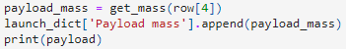
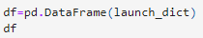
1.2 Data collection: web Scraping
The following tasks were performed to extract and clean the data from the Wikipedia page. I have also included some relevant code snippets used in each task. For the complete code please go to Github URL for Data Collection – Web Scraping
TASK 1: To request the Falcon9 Launch Wiki page from its URL
I performed an HTTP GET method to request the relevant HTML page as an HTTP response
I created a BeautifulSoup object from the HTML response
Task 2: To extract all column/variable names from HTML table header
I found all the tables on the webpage and iterated through the <th> elements to extract column names
Task 3: To create a data frame by parsing the launch HTML tables
I created an empty dictionary with keys from the extracted column names and then filled up the dictionary with launch records
I finally parsed the launch records into launch_dict and created a dataframe

Slide 12
2. Data wrangling
The following tasks were performed to initially explore the data and to determine what labels would be used for training the machine learning models. I have also included some relevant code snippets used in each task. For the complete code please go to Github URL for Data Wrangling
TASK 1: To calculate the number of launches on each site
I used the method .value_counts on the column LaunchSite to determine the number of launches at each site
TASK 2: To calculate the number and occurrence of each orbit
I used the method .value_counts() to determine the number and occurrence of each orbit in the column Orbit
TASK 3: To calculate the number and occurrence of landing outcomes by orbit type
I used the method .value_counts() on the column Outcome to determine the number of landing_outcomes.
I created a set of outcomes (bad_outcomes) where the second stage did not land successfully
TASK 4: To create a landing outcome label from Outcome column
Using the Outcome column, I created a list where the element is zero if the corresponding row in Outcome is in the set bad_outcome; otherwise, it's one. I then assigned it to the variable landing_class:

Slide 13
3. Exploratory Data Analysis (EDA)
This section is divided into two parts:
EDA with Visualisation
EDA using SQL

Slide 14


3.1 EDA WITH DATA VISUALISATION
I used a variety of charts from the Matplotlib and Seaborn libraries to help identify any patterns and trends within the data. The charts and associated code can be found at GitHub URL for EDA
To help visualize relationships between variables I used a variety or different charts: .
A Scatter Point Chart, which is good at showing the relationship between two numeric variables, was used to explore the relationship between:
Launch site and Flight Number
Payload Mass and Launch Site
Flight Number and Orbit Type
Payload Mass and Orbit Type
A Bar Chart, which is useful to compare different values across subgroups, was used to show how the Success Rate of each Orbit Type compared against one another
A Line Chart, which is good at showing changes over time, was used to visualize the yearly trend for Launch Successes.

Slide 15
3.2 EDA WITH sql
SQL was used to perform the following queries:
Display the names of the unique launch sites in the space mission
Display 5 records where launch sites begin with the string 'CCA’
Display the total payload mass carried by boosters launched by NASA (CRS)
Display average payload mass carried by booster version F9 v1.1
List the date when the first successful landing outcome in ground pad was achieved.
List the names of the boosters which have success in drone ship and have payload mass greater than 4000 but less than 6000
List the total number of successful and failure mission outcomes
List the names of the booster versions which have carried the maximum payload mass. Use a subquery
List the records which will display the month names, failure landing outcomes in drone ship, booster versions, launch site for the months in year 2015.
Rank the count of landing outcomes (such as Failure (drone ship) or Success (ground pad)) between the date 2010-06-04 and 2017-03-20, in descending order.
The SQL code can be found at GitHub URL for EDA with SQL

Slide 16
4. Data visualisation
This section is divided into two parts:
Building an interactive map using Folium
Building a dashboard with Plotly Dash

Slide 17
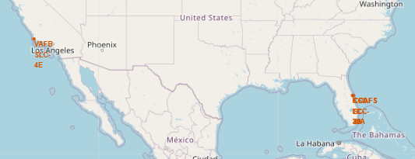
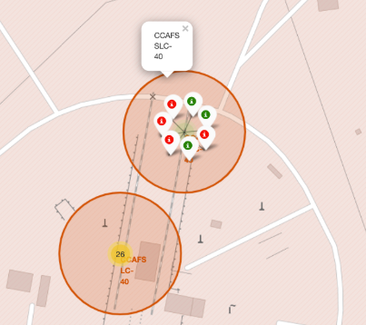
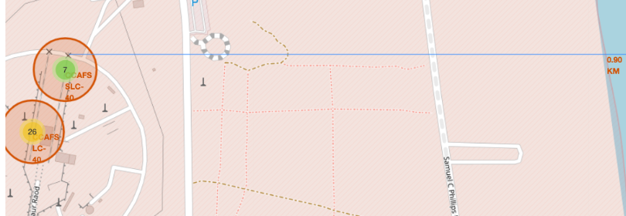
4.1 An interactive map using folium
Folium is a Python library that helps create several types of maps. It was used to create an interactive map of the launch sites used by SpaceX. The relevant code can be found at GitHub URL for Interactive Map with Folium
There were 3 main tasks performed by Folium:
Using Markers, all Launch sites were made easily visible on the map
Using a MarketCluster object, the launch successes at each site were clearly shown. Successful launches were marked in green whereas failures were marked in red
Finally, a PolyLine was used to plot the distances between a launch site and its proximity to roads, railways and coastlines

Slide 18

4.2 Dashboard using plotly dash
Plotly Dash was used to create an interactive application to enable users to easily visualize SpaceX launch data in real-time. The relevant code to create the dashboard can be found at GitHub URL for Dash App
The dashboard contains a number of features including:
A Drop-down component to allow users to select the launch site they want to analyse
A callback function to render a Pie-chart based on the selected site dropdown choice
A Range Slider to select a range of different Payloads
A Callback function to render a Scatter Plot showing the relationship between launch outcome and the selected Payload range

Slide 19

5. Predictive analysis (classification)
A machine learning pipeline was developed to predict if the first stage will land. Details of the code can be found at GitHub URL for Machine Learning prediction
Scikit was used to access a variety of ML classification models.
The main steps in the process were:
Loading the data into a data-frame and standardising it
Splitting the data into training and testing data using the function train_test_split
The following classification models were evaluated: Logistic Regression, Support Vector Machine (SVM), Decision Tree, and K Nearest Neighbours (KNN)
To fit the models to the training data, GridSearchCV is used to find the best parameters
Each trained model is then tested using the testing data set
An accuracy score is then calculated

Slide 20

4. results

Slide 21
results
This section outlines the key results from the exploratory data analysis and is divided into four main areas:
Insights from the EDA
Proximity analysis of the launch sites
Interactive dashboard using Plotly Dash
Predictive Analysis

Slide 22
1. Insights from EDA
The following slides provide details of the results from the EDA. Charts, tables and code snippets have been presented to help display the findings.

Slide 23
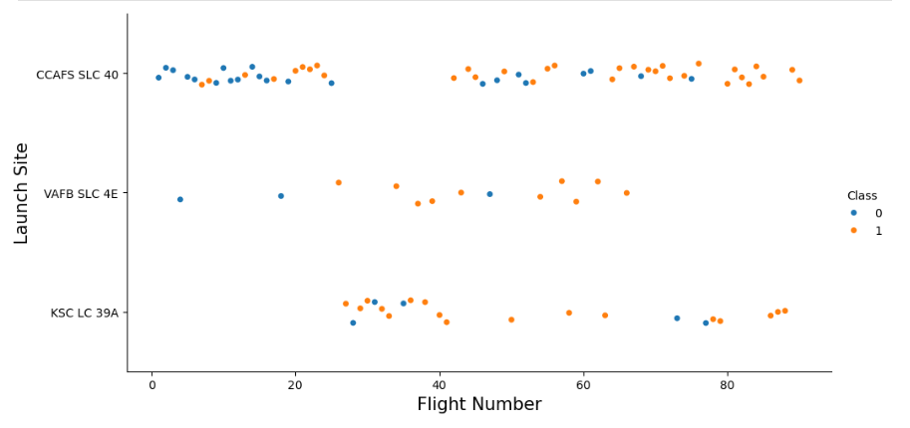
Flight Number vs. Launch Site
The scatter chart shows the relationship between flight number and launch site. Some key observations include:
All flights after 80 were successful (Class 1)
The first 20 flights suffered a high proportion of failures (15/20 or 75%)
VAFB launch site was discontinued after launch 70
Notes:
Show a scatter plot of Flight Number vs. Launch Site
Show the screenshot of the scatter plot with explanations

Slide 24
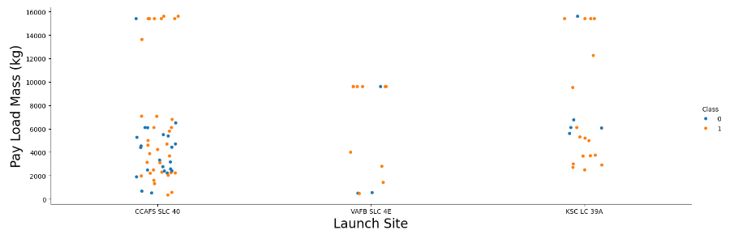
Payload vs. Launch Site
The scatter chart shows the relationship between payload and launch site. Some key observations include:
At VAFB-SLC, there were no flights where the payload was above 10,000kg
Landings at KSC-LC where Payloads were below 5000kg, were all successful
Notes:
Show a scatter plot of Payload vs. Launch Site
Show the screenshot of the scatter plot with explanations

Slide 25
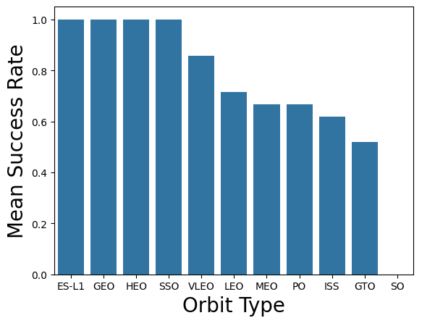
Success Rate vs. Orbit Type
The bar chart opposite shows the relative success rate by Orbit type.
It’s clear to see that the most successful Orbit types are ES-L1, GEO, HEO & SSO.
They all had a mean success rates of 100%. At the opposite end of the scale, Orbit type SO had a 0% success rate
Notes:
Show a bar chart for the success rate of each orbit type
Show the screenshot of the scatter plot with explanations

Slide 26
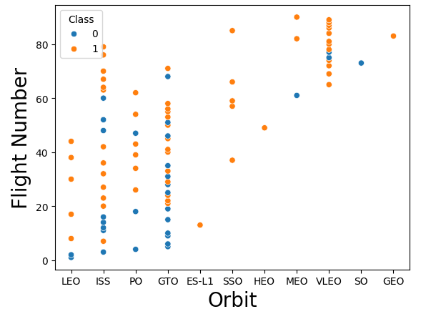
Flight Number vs. Orbit Type
The scatter plot of flight number vs orbit type shows some interesting patterns.
At LEO, success seems to be related to higher flight numbers, whereas at GTO, there is no clear relationship.
VLEO became the most popular orbit for later flight numbers (>60)
Notes:
Show a scatter point of Flight number vs. Orbit type
Show the screenshot of the scatter plot with explanations

Slide 27
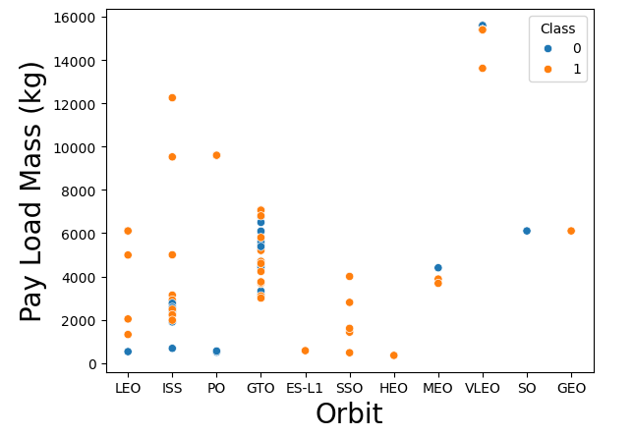
Payload vs. Orbit Type
The chart illustrates that for LEO & ISS, heavier payloads are more successful
Again, it is difficult to identify any clear pattern for successful landings at GTO
Notes:
Show a scatter point of payload vs. orbit type
Show the screenshot of the scatter plot with explanations

Slide 28
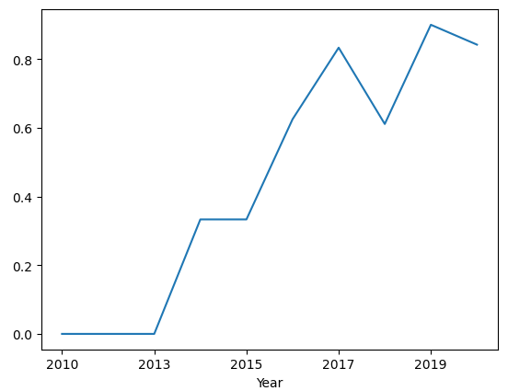
Average success rate per year
Launch Success Yearly Trend
Despite a fall in 2018, the average success rate for landings has increased every year from 2013 to 2019
Average success rate
Notes:
Show a line chart of yearly average success rate
Show the screenshot of the scatter plot with explanations

Slide 29
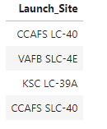
All Launch Site Names
The following names are unique launch sites:
The following SQL query was used to extract this information from the SPACEXTBL table:
Notes:
Find the names of the unique launch sites
Present your query result with a short explanation here

Slide 30
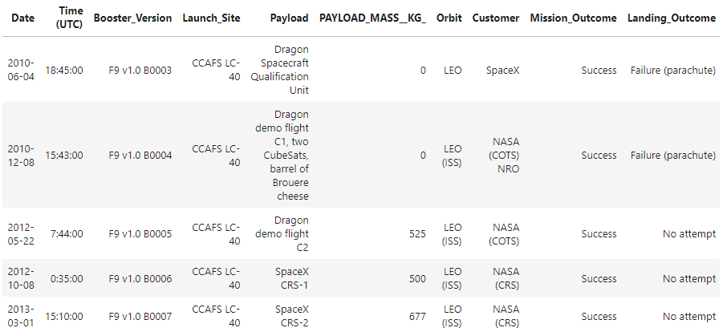
Launch Site Names Begin with 'CCA'
Using the following SQL query, I was able to extract 5 records where launch site names began with ‘CCA’
Notes:
Find 5 records where launch sites begin with `CCA`
Present your query result with a short explanation here

Slide 31
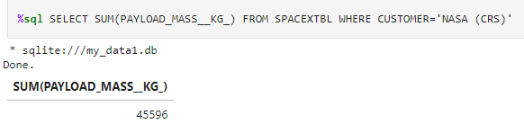
Total Payload Mass
Using the following SQL query, I was able to calculate the total payload mass carried by boosters launched by NASA (CRS) was 45,596 kg:
Notes:
Calculate the total payload carried by boosters from NASA
Present your query result with a short explanation here

Slide 32
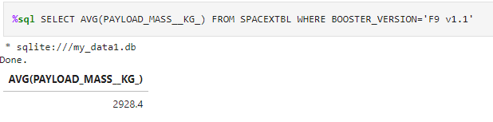
Average Payload Mass by F9 v1.1
Using the following SQL query, I was able to calculate the average (mean) payload mass carried by the booster version F9 v1.1 was 2,928 kg:
Notes:
Calculate the average payload mass carried by booster version F9 v1.1
Present your query result with a short explanation here

Slide 33
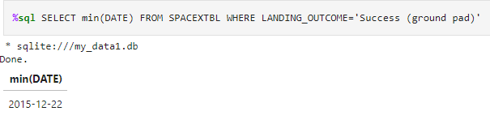
First Successful Ground Landing Date
Using the following SQL query, I was able to find that first successful landing on ground pad was 22nd December 2015:
Notes:
Find the dates of the first successful landing outcome on ground pad
Present your query result with a short explanation here

Slide 34
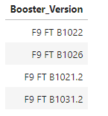
Successful Drone Ship Landing with Payload between 4000 and 6000
Using the following SQL query, I was able to list the names of the boosters of successful drone ship landings with payloads between 4,000 and 6,000 kg:
%sql SELECT BOOSTER_VERSION FROM SPACEXTBL WHERE PAYLOAD_MASS__KG_ between 4000 and 6000 AND LANDING_OUTCOME='Success (drone ship)'
Notes:
List the names of boosters which have successfully landed on drone ship and had payload mass greater than 4000 but less than 6000
Present your query result with a short explanation here

Slide 35
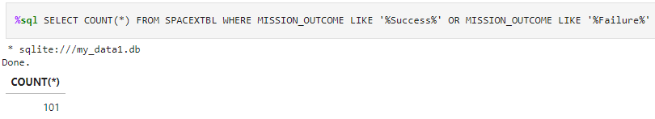
Total Number of Successful and Failure Mission Outcomes
Using the following SQL query, I was able to calculate that the total number (count) of successful and failed mission outcomes was 101:
Notes:
Calculate the total number of successful and failure mission outcomes
Present your query result with a short explanation here

Slide 36
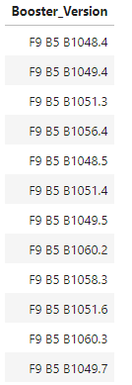
Boosters Carried Maximum Payload
Using the following SQL query, I was able to find the names of the booster versions which carried the maximum payload:
Notes:
List the names of the booster which have carried the maximum payload mass
Present your query result with a short explanation here

Slide 37
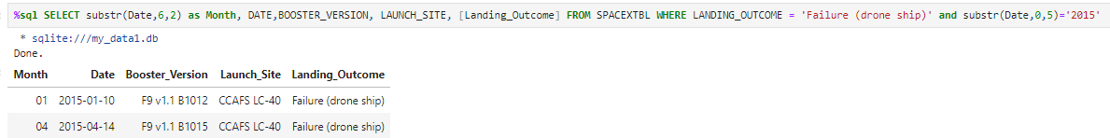
2015 Launch Records
Using the following SQL query, I was able to find the failed launch records for the drone ship and booster versions in 2015:
Notes:
List the failed landing_outcomes in drone ship, their booster versions, and launch site names for in year 2015
Present your query result with a short explanation here

Slide 38
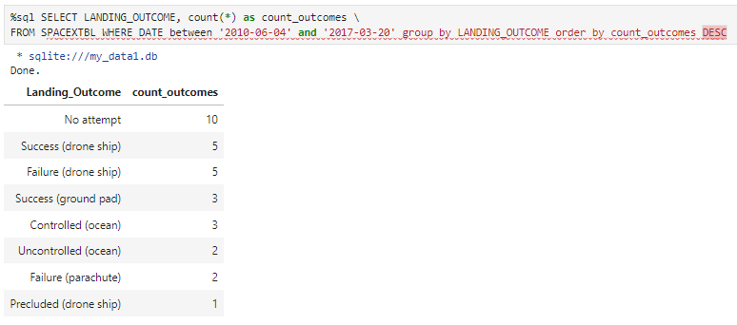
Rank Landing Outcomes Between 2010-06-04 and 2017-03-20
Using the following SQL query, I was able to rank, in descending order, the landing outcomes between 4th June 2010 and 20th March 2017:
Notes:
Rank the count of landing outcomes (such as Failure (drone ship) or Success (ground pad)) between the date 2010-06-04 and 2017-03-20, in descending order
Present your query result with a short explanation here

Slide 39
2. Proximity analysis of the launch sites
The following slides provide details of the results from the proximity analysis using Folium.

Slide 40
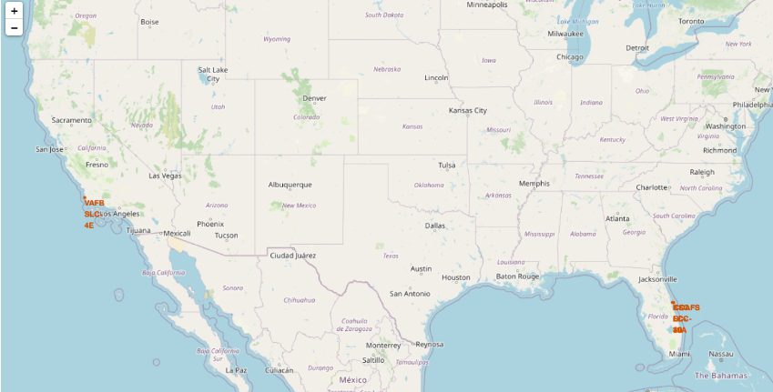
Global map showing the location of all the launch sites
From the map we can see that all the launch sites are located near the ocean and close to the equator.
Being located near the ocean helps reduce the risk of launching near populated areas
Being closer to the equator allows the rocket to take optimum advantage of the Earth’s rotational speed, giving the rockets an extra boost and reduce the amount of fuel needed.
Notes:
Replace <Folium map screenshot 1> title with an appropriate title
Explore the generated folium map and make a proper screenshot to include all launch sites’ location markers on a global map
Explain the important elements and findings on the screenshot

Slide 41
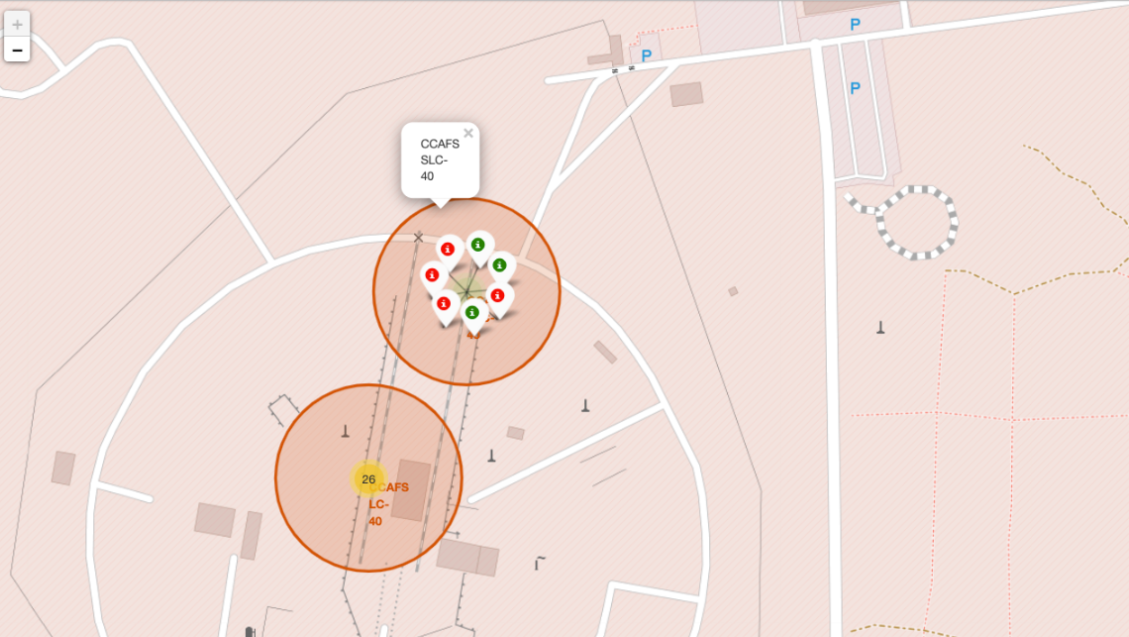
Using markers to display launch records
From the screenshot, the launch site CCAFS SLC-40 has been highlighted.
Red markers have been used to depict failed launches and green markers to highlight successful ones.
The image clearly shows that there were 4 failed launches and 3 successful ones at this site
Notes:
Replace <Folium map screenshot 2> title with an appropriate title
Explore the folium map and make a proper screenshot to show the color-labeled launch outcomes on the map
Explain the important elements and findings on the screenshot

Slide 42
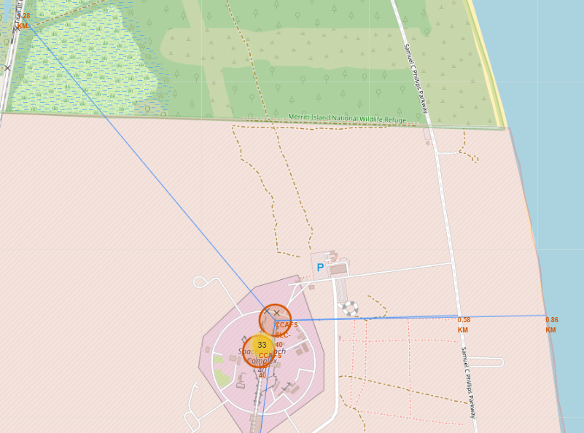
Launch site distances to its proximities
Using blue lines, the distances from sites to nearby geographical features such as coastlines, railways and roads were plotted and calculated.
For example, the distance to the coast from CCAFS SLC-40 is approximately 0.86km
Notes:
Replace <Folium map screenshot 3> title with an appropriate title
Explore the generated folium map and show the screenshot of a selected launch site to its proximities such as railway, highway, coastline, with distance calculated and displayed
Explain the important elements and findings on the screenshot

Slide 43
3. Interactive dashboard using Plotly Dash
The following slides provide screenshots and explanations of the interactive dashboard created in Plotly Dash

Slide 44
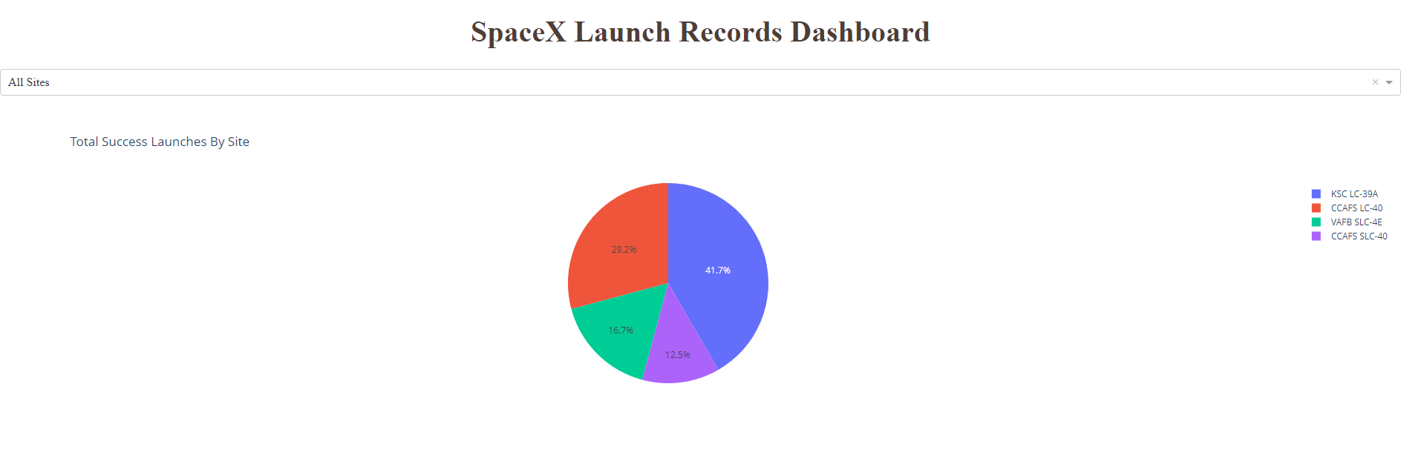
Total successful launches across all sites
The screenshot above from the Dash application shows the success count for all sites as a percentage of total successful launches
KSC LC 39A contributed the highest percentage, accounting for 41.7% of all successful launches, whereas CCAFS SLC-40 had the lowest success rate at 12.5%
Notes:
Replace <Dashboard screenshot 1> title with an appropriate title
Show the screenshot of launch success count for all sites, in a piechart
Explain the important elements and findings on the screenshot

Slide 45
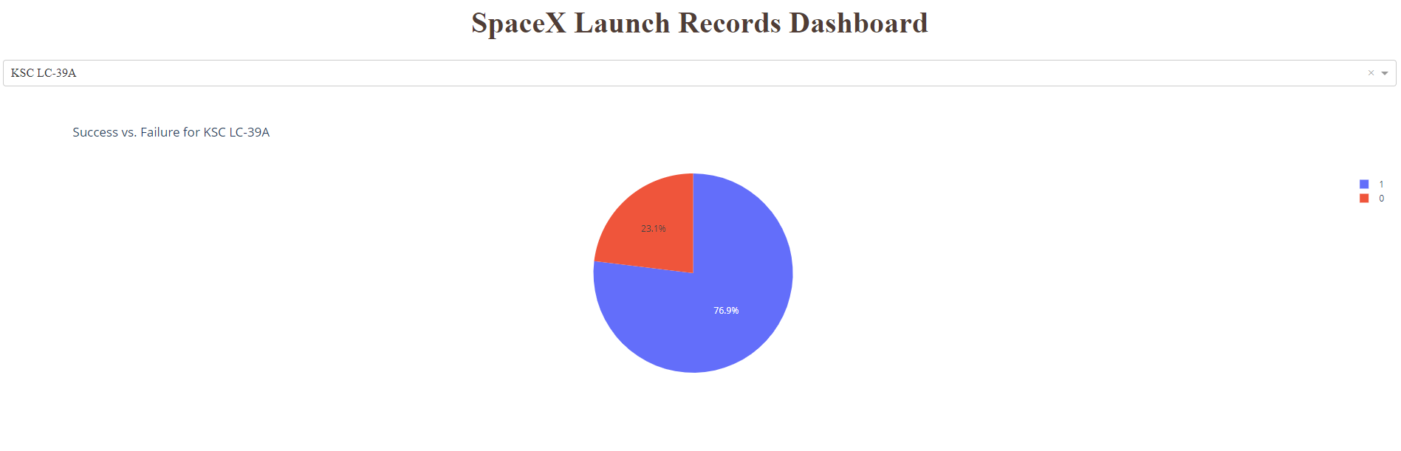
Launch site with the highest success ratio
Drilling down into the launch site with the highest success rate, KSC LC-39A, it is clear from the screenshot above that this site achieved a launch success rate of 76.9% versus a failure rate of 23.1%
Notes:
Replace <Dashboard screenshot 2> title with an appropriate title
Show the screenshot of the piechart for the launch site with highest launch success ratio
Explain the important elements and findings on the screenshot

Slide 46
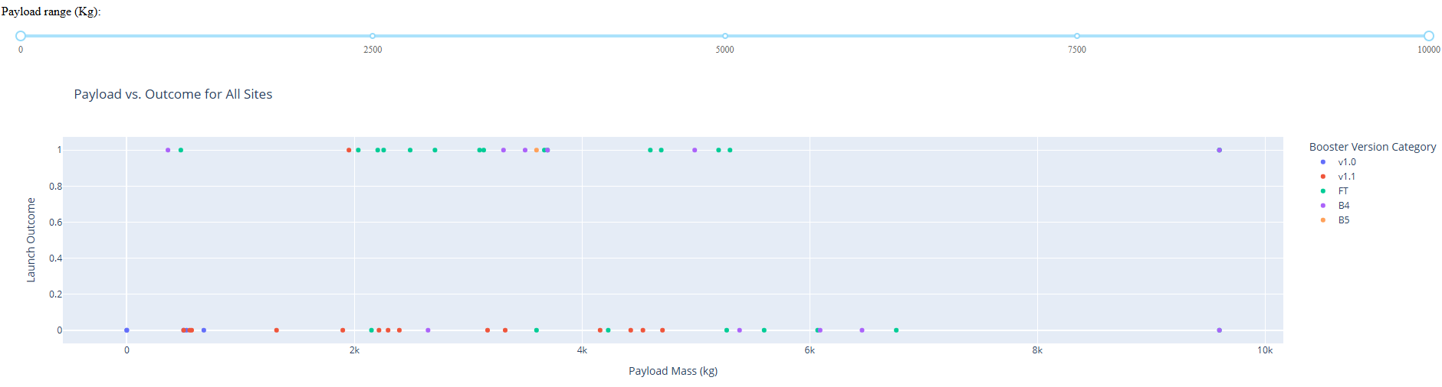
Payload versus Launch Outcome for all sites
This screenshot shows the launch outcome (success =1, failure = 0) for all sites
The range slider for Payload has been set to 10,000 kg. From this, we can clearly see that the Booster version FT has the highest number of successful outcomes (green dots)
We can also see that the most successful Payload (kg) is between 2k to 6k, however, this range also contains the most failures
The next two slides show results for different Payload ranges by adjusting the Payload slider
Notes:
Replace <Dashboard screenshot 3> title with an appropriate title
Show screenshots of Payload vs. Launch Outcome scatter plot for all sites, with different payload selected in the range slider
Explain the important elements and findings on the screenshot, such as which payload range or booster version have the largest success rate, etc.

Slide 47
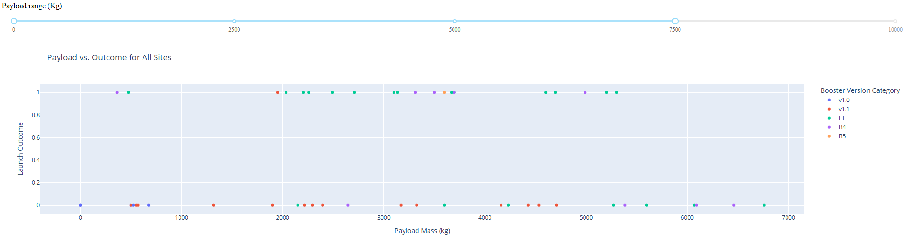
Payload range up to 7,500 kg
The Payload slider has been set to a maximum of 7,500kg. This enables us to zoom into the results for this range.
It’s clear to see that there were no successful outcomes between 6,000 and 7,000 kg
Notes:
Replace <Dashboard screenshot 3> title with an appropriate title
Show screenshots of Payload vs. Launch Outcome scatter plot for all sites, with different payload selected in the range slider
Explain the important elements and findings on the screenshot, such as which payload range or booster version have the largest success rate, etc.

Slide 48
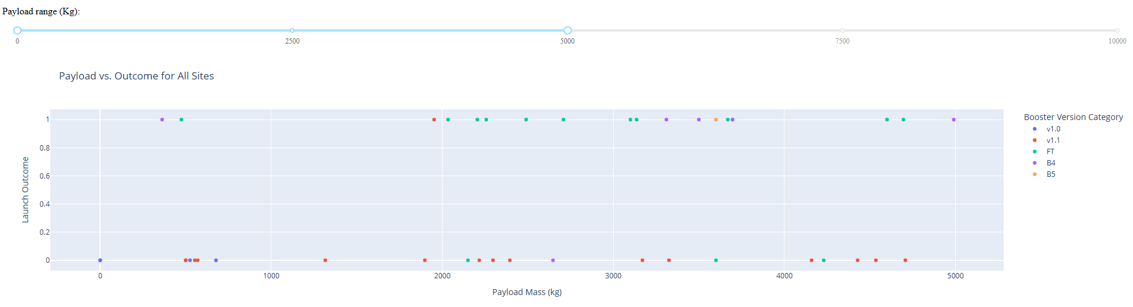
Payload range up to 5,000 kg
The Payload slider has been set to a maximum of 5,000kg. This enables us to zoom into the results for this range.
It’s clear to see that between 1,000 and 2,000kg there was only 1 successful outcome using Booster version v1.1
Notes:
Replace <Dashboard screenshot 3> title with an appropriate title
Show screenshots of Payload vs. Launch Outcome scatter plot for all sites, with different payload selected in the range slider
Explain the important elements and findings on the screenshot, such as which payload range or booster version have the largest success rate, etc.

Slide 49
4. Predictive analysis
The following slides shows a comparison of how each of the predictive models performed based on their accuracy score. A confusion matrix, highlighting the number of true positives and false negatives, is also displayed.

Slide 50
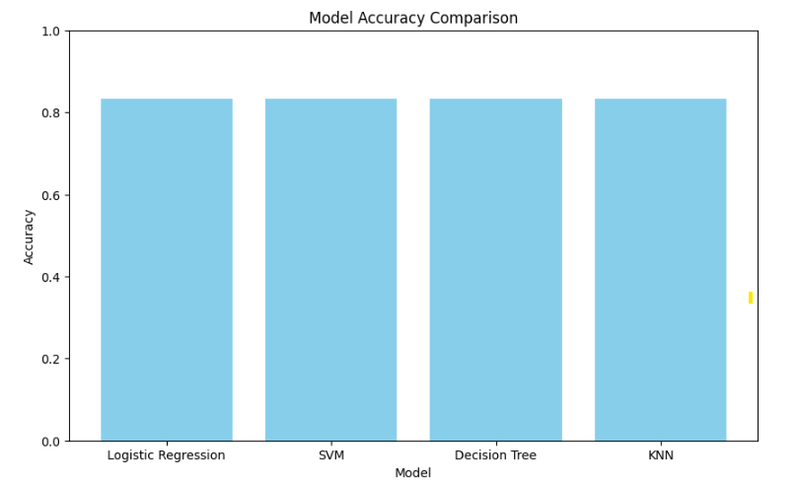
Classification Accuracy
The bar chart shows that models have the same accuracy score of 0.833
This is likely because the size of the test data is relatively small
Notes:
Visualize the built model accuracy for all built classification models, in a bar chart
Find which model has the highest classification accuracy

Slide 51
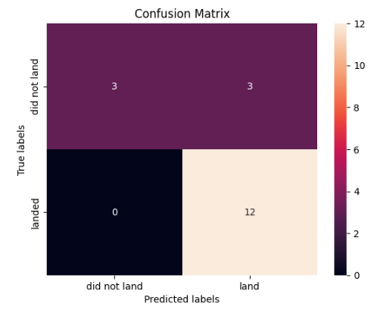
Confusion Matrix
This confusion matrix is the same for each classification model
All models have 12 True Positives & 3 False Negatives
Notes:
Show the confusion matrix of the best performing model with an explanation

Slide 52

5. Conclusion

Slide 53
conclusion
The following main conclusions can be drawn from this analysis:
All models perform equally with a test accuracy of 83.33%
As the Payload increases beyond 5,000 kg the success rate falls dramatically
The launch site with the highest success rate of 76.9% is KSC LC-39A
Despite a fall in 2018, the average success rate for landings has increased every year from 2013 to 2019
Orbit types ES-L1, GEO, HEO & SSO all had a mean success rates of 100%.

Slide 54
Thank you

